Slide 1


STUBBLE AGGREGATION & ITS PROPER DISPOSAL
Theme – Waste Management
PSID – AN316
PSO -
Our Solution -

Slide 2
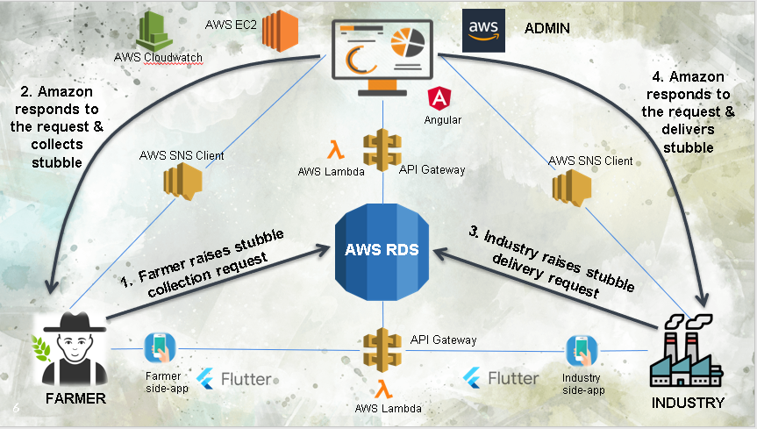
SOLUTION TILL NOW
Our solution aims towards creating an interface between Farmers and Industries with Amazon Web Services acting as the middleman facilitating the whole process.

Slide 3
Key Points to be covered
Blockchain Implementation for transaction
SMS service Implementation
System Security
Distributed system in RDS (scalability)
Business Model 2.0 in depth analysis

Slide 4
SMS Service
Idea requires a timely status notifications for both farmers and companies.
We keep in mind that farmers will not have email ids.
So, AWS SNS Client is used for SMS notifications.
AWS SNS is integrated in AWS Lambdas for timely notifications for both farmers as well as farmers.
This ensures the process transparency.

Slide 5








System Security
AWS RDS
AWS Lambda
AWS Lambda
API Gateway
API Gateway
Cognito User Pool
&
Selected domains
Cognito User Pool
ADMIN DASHBOARD
APPS

Slide 6
Centralized vs Distributed
Cost effective
Vertical scaling is allowed but there is a limit for storage.
Very powerful for data visualization and complex querying.
Single point of failure issue
Contains a single global clock.
Relatively costly
Storage is not an issue
Makes data visualization & complex querying very difficult
No such thing as single point of failure.
No common clock causes difficulty in various tasks.

Slide 7
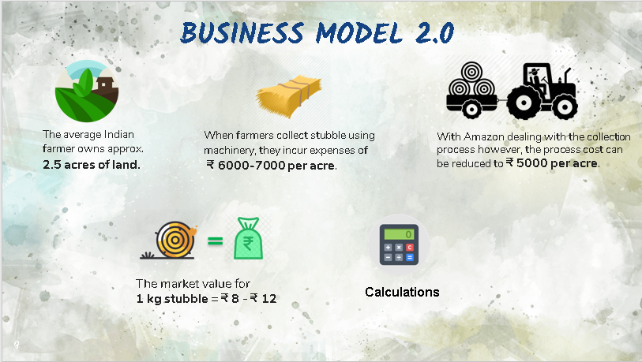

Slide 8
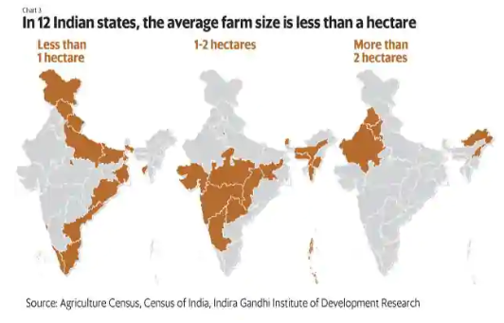
Punjab and Haryana, two states known for their agricultural output, also have larger farm sizes (3.6ha in Punjab and 2.2ha in Haryana).
The majority of India’s farms (86%) are less than 2ha.
The average landholding size of an household has shrunk marginally to 1.1ha according to a rural survey carried out by the National Bank for Agriculture and Rural Development (Nabard).

Slide 9
The stubble processing cost comes around Rs 6,000-7,000 per acre.
The cost of stubble processing includes :-
Rent of machinery ( Rs. 3500 to Rs. 5000)
Diesel charge and (4-5 ltr per acre = Rs. 75 x 4 = Rs. 300)
Labour charges, crushing of straw and other costs
Farmers prefer to burn stubble and pay penalty rather than weed out the stubbles. And the reason for this is that the cost of stubble burning is cheaper as penalty works out to be around Rs 2,500 per acre.
Notes:
The rental cost of combine harvester is Rs 3,500 to Rs 5,000 per acre which includes transportation charge. The cost of diesel is also borne by the farmer. Four to five litre diesel needs per acre. If the cost of labour, crushing of straw cost and other costs included, it will come around Rs 6,000 to Rs 7000 per acre in Punjab and Haryana," said Sewa Singh, a farmer and member of Bharatiya Kisan Union (BKU) in Karnal

Slide 10

Taxation and other Govt Policies
In a bid to curb stubble burning, the National Green Tribunal (NGT) also directed States to adopt a multi-method approach through in situ and ex situ management of crop residue.
Various claims had been made in compliance with the Supreme Court order on stubble burning, wherein states decided to pay its small and marginal farmers Rs 100 per quintal for non-basmati produce against a commitment that they won’t burn stubble.
Agricultural Income – As per the Income Tax Act, 1961 agricultural income earned by a taxpayer in under Section 10(1) is exempted. Agricultural income is defined under section 2(1A) of the Income-tax Act.
GST on stubble - According to the RATE OF GST ON GOODS list published on 3rd May 2017, straw and fodder comes under chapter 1213 of the goods that have nil GST.
Notes:
As per section 2(1A), agricultural income generally means (a) Any rent or revenue derived from land which is situated in India and is used for agricultural purposes. (b) Any income derived from such land by agriculture operations including processing of agricultural produce so as to render it fit for the market or sale of such produce. (c) Any income attributable to a farm house subject to satisfaction of certain conditions specified in this regard in section 2(1A). Any income derived from saplings or seedlings grown in a nursery shall be deemed to be agricultural income.

Slide 11
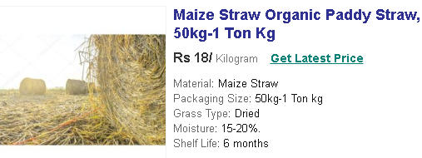
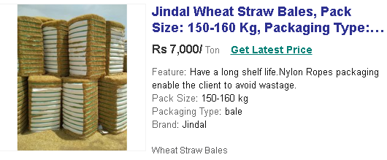
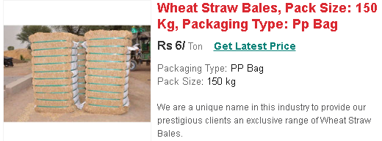
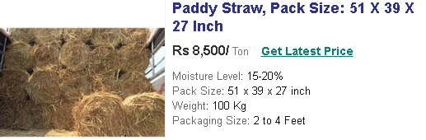
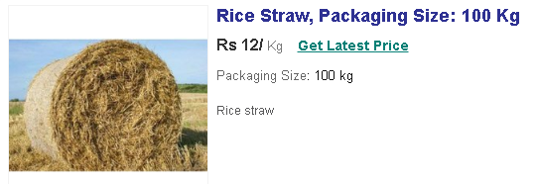
Stubble Market Value

Slide 12
According to government agencies 2500 Kg- 3000 Kg of stubble is collected from 1 acre of land.
Min
Max
So the amount for 2500 Kg of stubble = Rs. 8 * 2500 = ₹ 20,000
Therefore, Profit per acre
= 20,000 – 5,000 = 15,000 ₹/acre
On an average profit from every piece of land = 15,000 * 2.5
= ₹ 37,500
So the amount for 3000 Kg of stubble = Rs.12 * 3000 = ₹ 36,000
Therefore, Profit per acre
= 36,000 – 5,000 = 31,000 ₹/acre
On an average profit from every piece of land = 31,000 * 2.5
= ₹ 77,500
Notes:
https://www.bloombergquint.com/politics/as-nearby-states-report-350-stubble-fires-in-seven-days-delhi-prepares-to-deal-with-bad-air
https://cdn.s3waas.gov.in/s38cb22bdd0b7ba1ab13d742e22eed8da2/uploads/2019/11/2019110595.pdf

Slide 13
References
https://www.thehindubusinessline.com/economy/agri-business/average-farm-landholding-size-shrinks-to-11-ha/article24719240.ece
https://dir.indiamart.com/search.mp?ss=sugarcane+straw+bales&mcatid=20986&catid=700
https://timesofindia.indiatimes.com/blogs/toi-edit-page/manage-stubble-to-control-air-pollution-recycling-it-can-reduce-weedicide-use-by-70-and-water-use-by-40/ https://www.drishtiias.com/daily-updates/daily-news-editorials/stubble-burning-2
https://www.dw.com/en/india-pollution-how-a-farming-revolution-could-solve-stubble-burning/a-51166417
https://www.thequint.com/explainers/stubble-burning-delhi-air-pollution-smog
https://www.downtoearth.org.in/blog/agriculture/stubble-burning-a-problem-for-the-environment-agriculture-and-humans-64912
https://www.downtoearth.org.in/blog/agriculture/agrarian-crisis-one-of-the-biggest-challenges-for-new-govt-64736
https://economictimes.indiatimes.com/news/economy/agriculture/centre-to-come-out-with-permanent-solution-to-stubble-burning-mos-agriculture/articleshow/72294049.cms?from=mdr
https://en.wikipedia.org/wiki/Stubble_burning
https://www.gov.mb.ca/agriculture/crops/crop-residue-burning-program/why-do-farmers-burn.html

Slide 14

- Team Brain Stormers

